Slide 1
Activity Recognizer
Marco Pardini | Mobile And Social Sensing Systems | 2021/2022

Slide 2

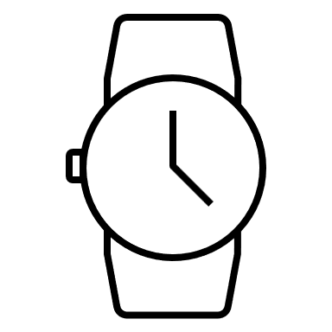

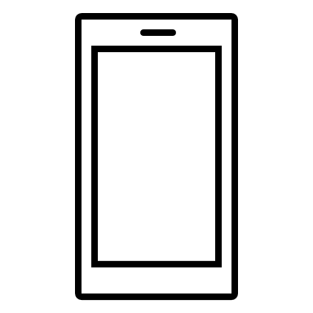


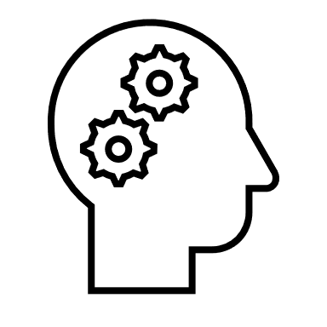


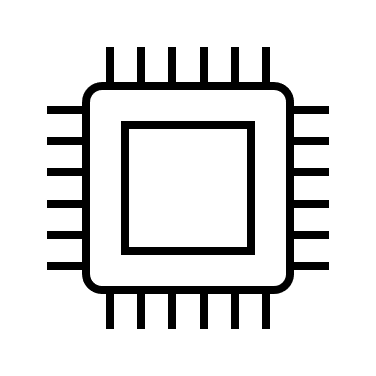
Introduction
Activity Recognition:
“A process that aims to recognize the actions of one or more agents from a series of observations”
Interested fields in activity recognition:
Healthcare
Surveillance
Remote care to elderly people
Smart home/office/city
Monitoring applications in sports or exercise
Devices able to do activity recognition:
Wearable sensors
Smartphone inertial sensors
Camera devices (like Kinect)
Closed circuit television
Commercial electronic equipment

Slide 3

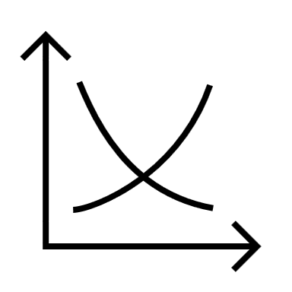

Project purpose
Core idea:
Discover the true complexity behind activity recognition, starting from scratch
Objectives:
Find out if there are differences between sensors in different phones (and brands)
Building a classification model able to correctly distinguish between different activities
Creating an Android application that can be used to monitor the user’s movements and activities along the day
ActivityRecognitionClient from Google Play Services
In vehicle
On foot
Running
Walking
On bicycle
Still

Slide 4
Project workflow
Exploratory data analysis
Pre processing
Feature extraction
Feature redundancy and selection
Model evaluation
Application highlights

Slide 5
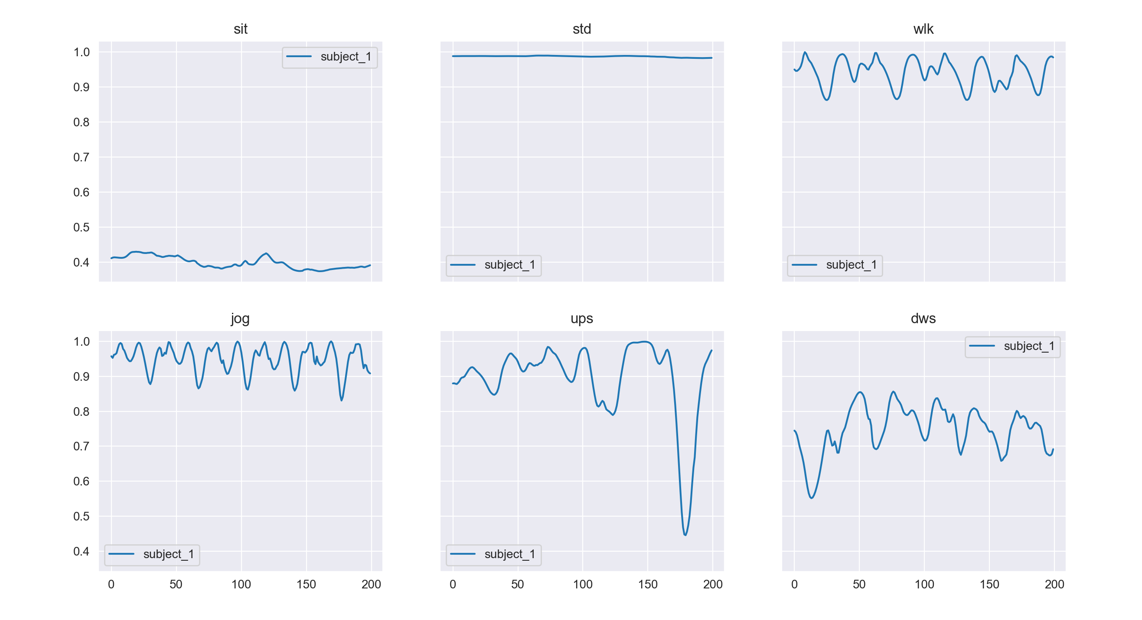
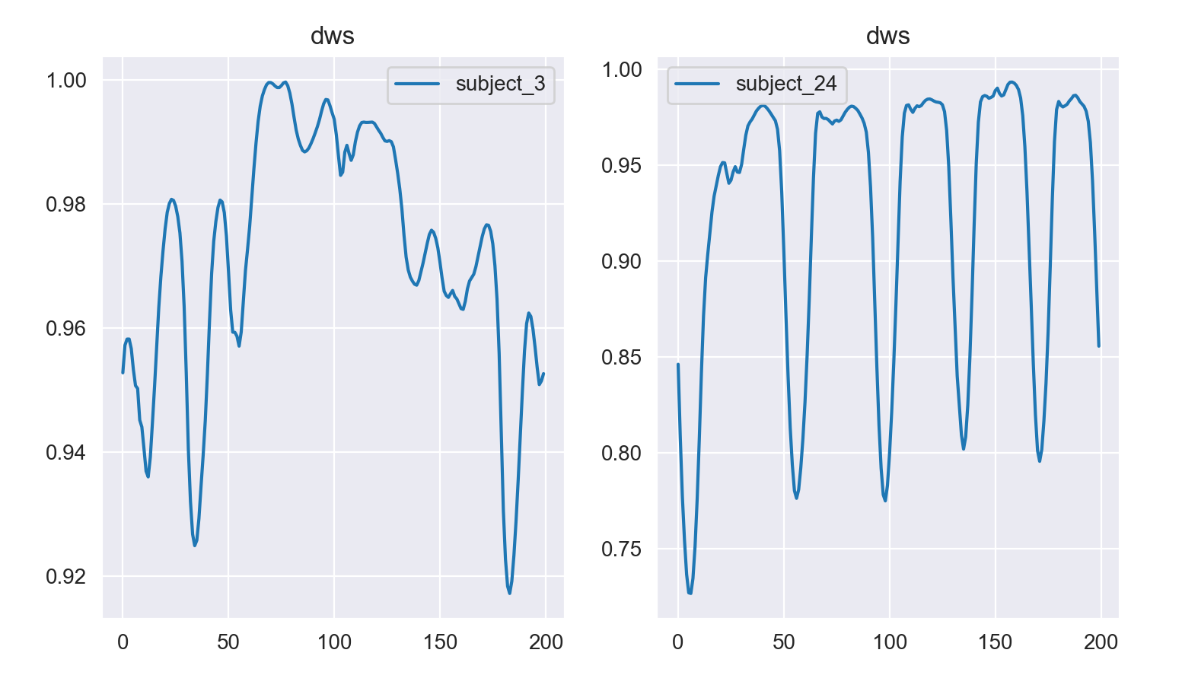
Exploratory data analysis
“A_Device_Motion_Data”
Time-series generated by accelerometer and gyroscope sensors
Iphone 6s kept in partecipants’ front pocket
24 partecipants in a range of gender, age, weight and height
6 activities: sitting, standing, walking, jogging, going upstairs and downstairs
15 trials for each activity in the same environment and conditions
Different behaviours in the same activity for different subjects

Slide 6
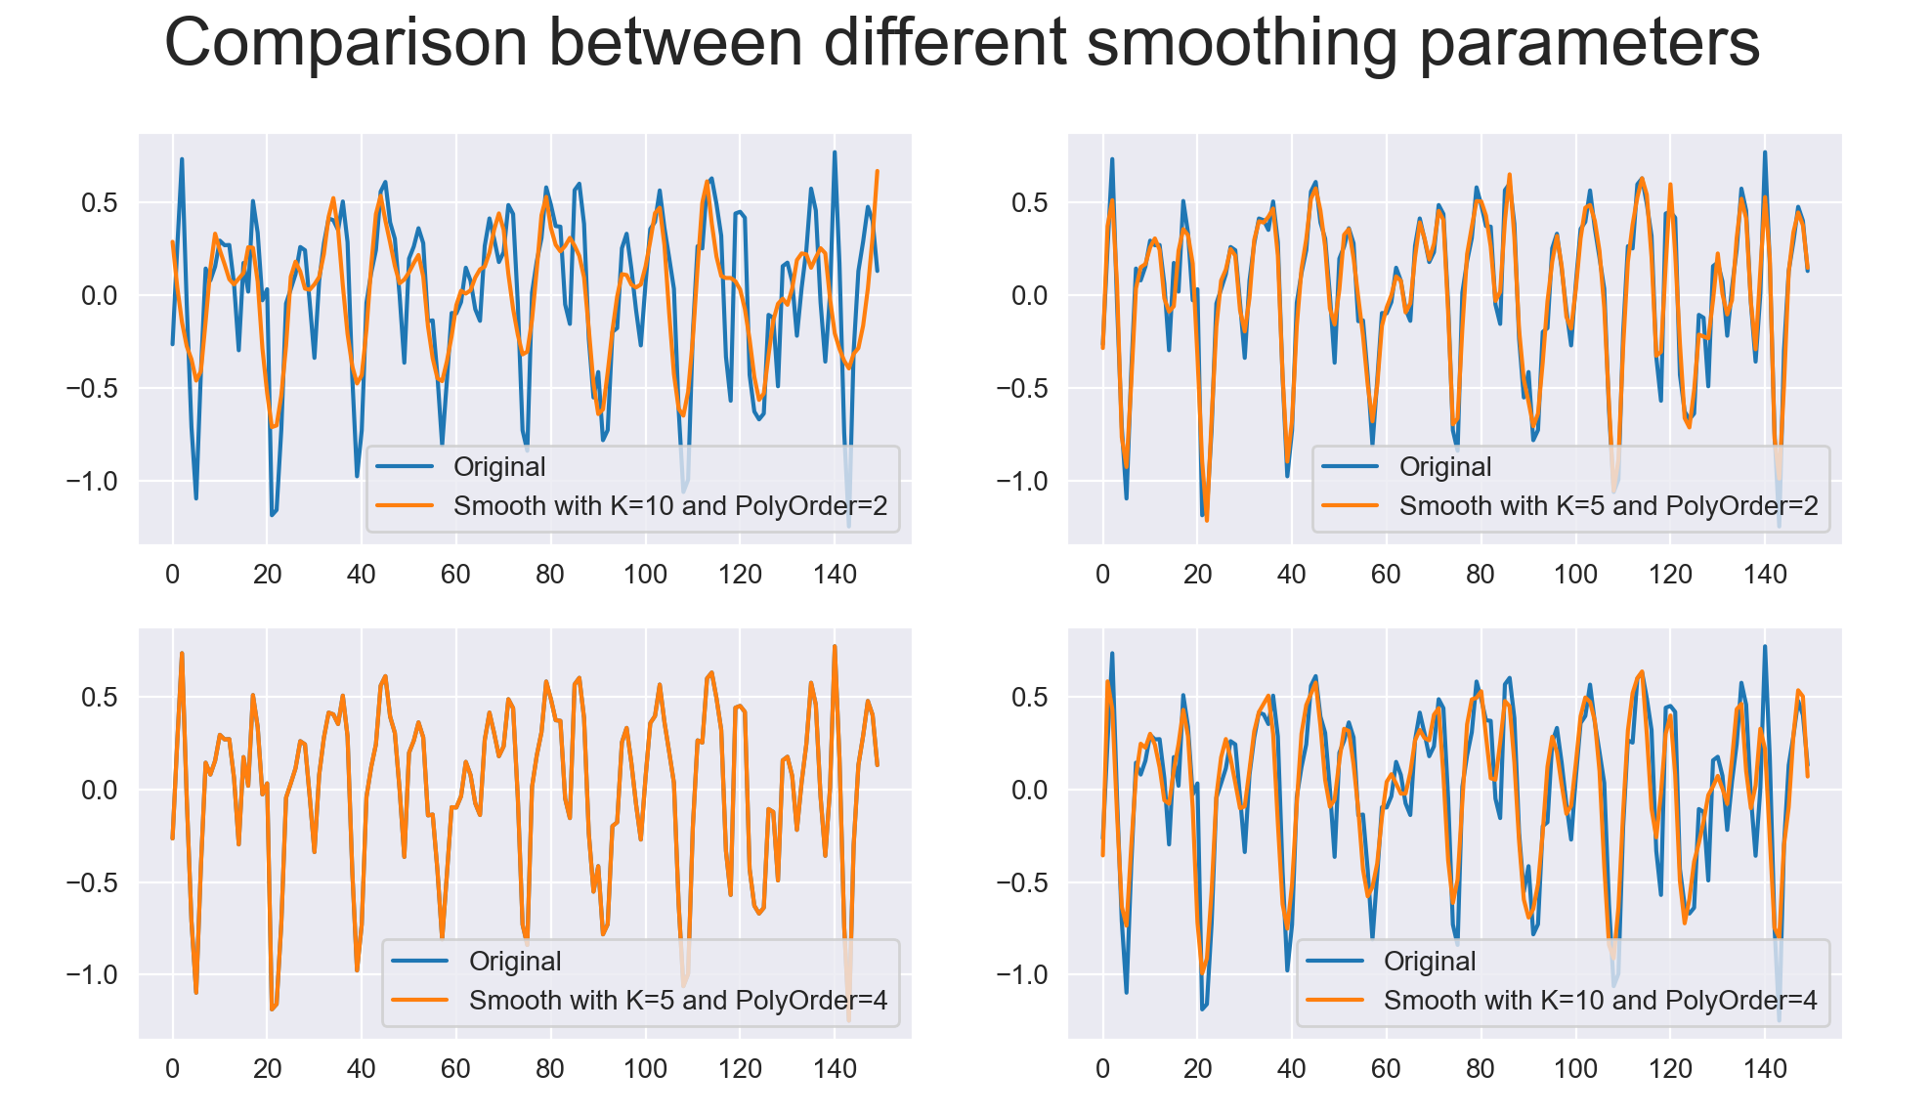
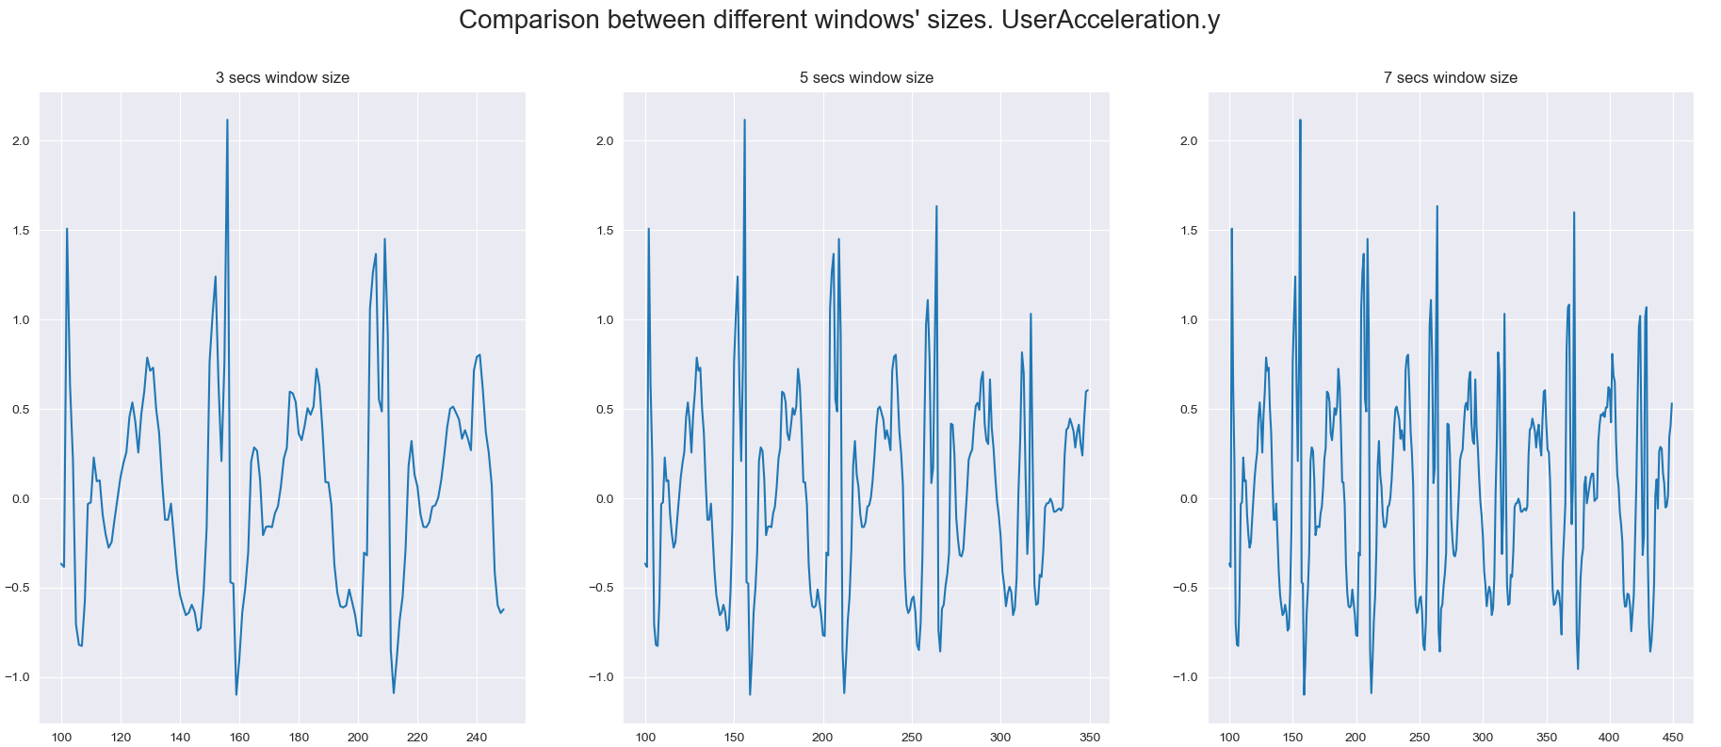
Pre processing
Comparison between different smoothing parameters
Comparison between different window’s sizes

Slide 7
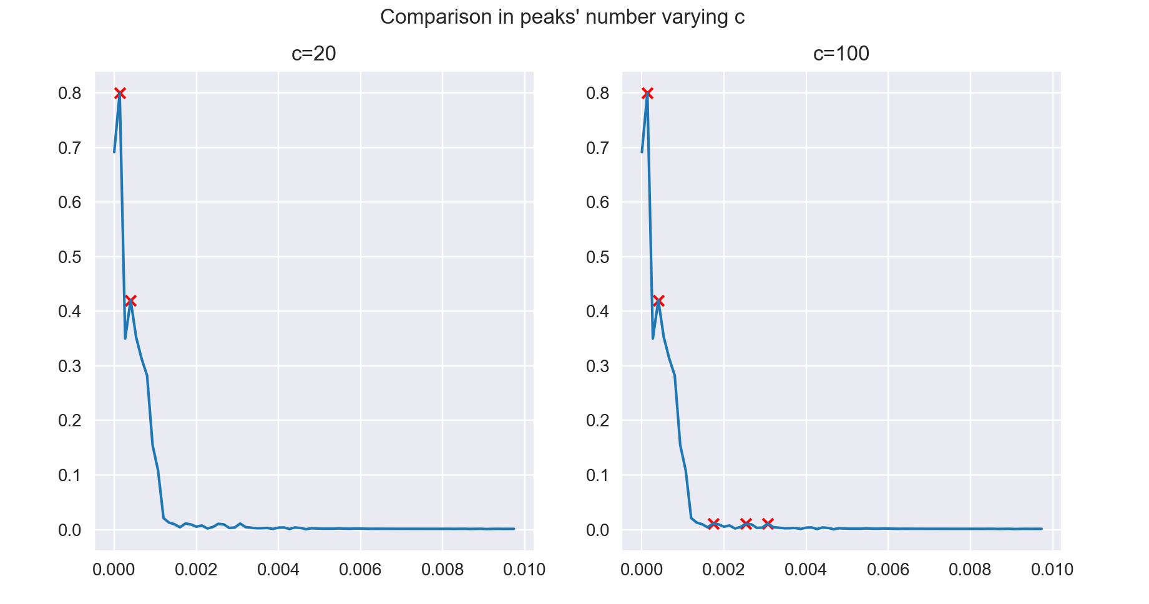
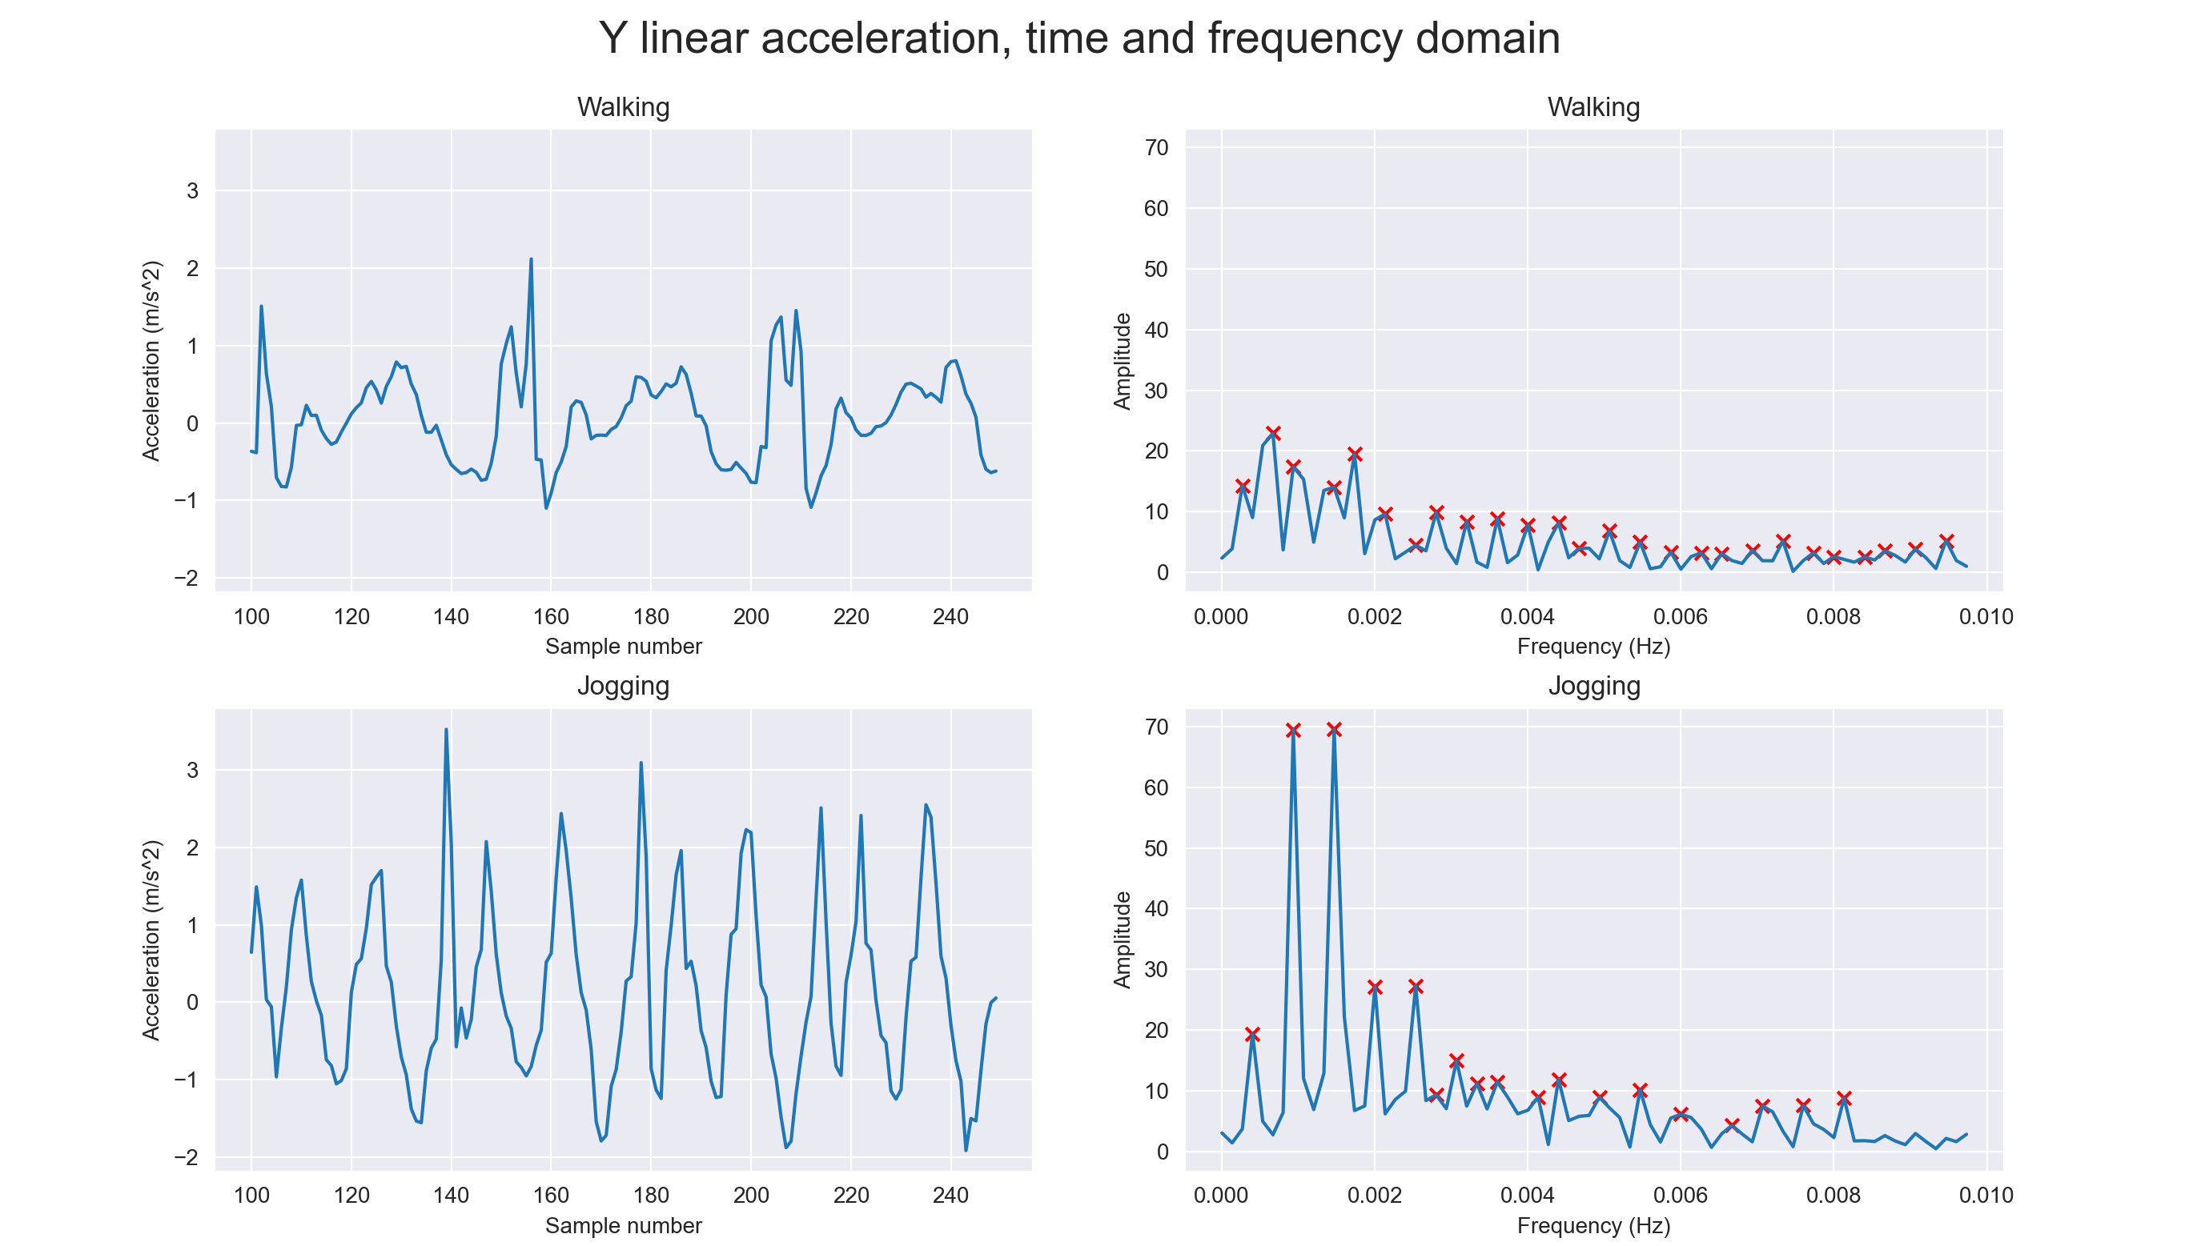
Feature extraction
Time domain | Frequency domain
Mean, standard deviation, range, interquartile range, kurtosis, skewness | First 5 peaks’ position and amplitude

Slide 8
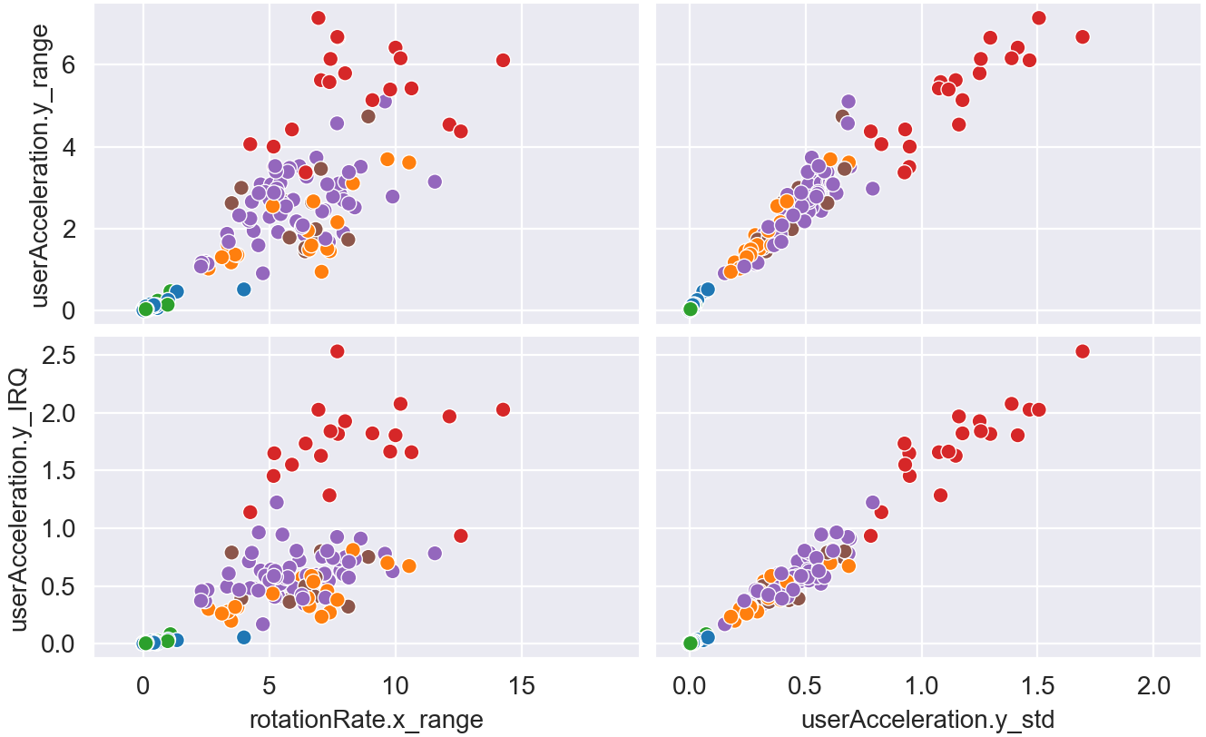
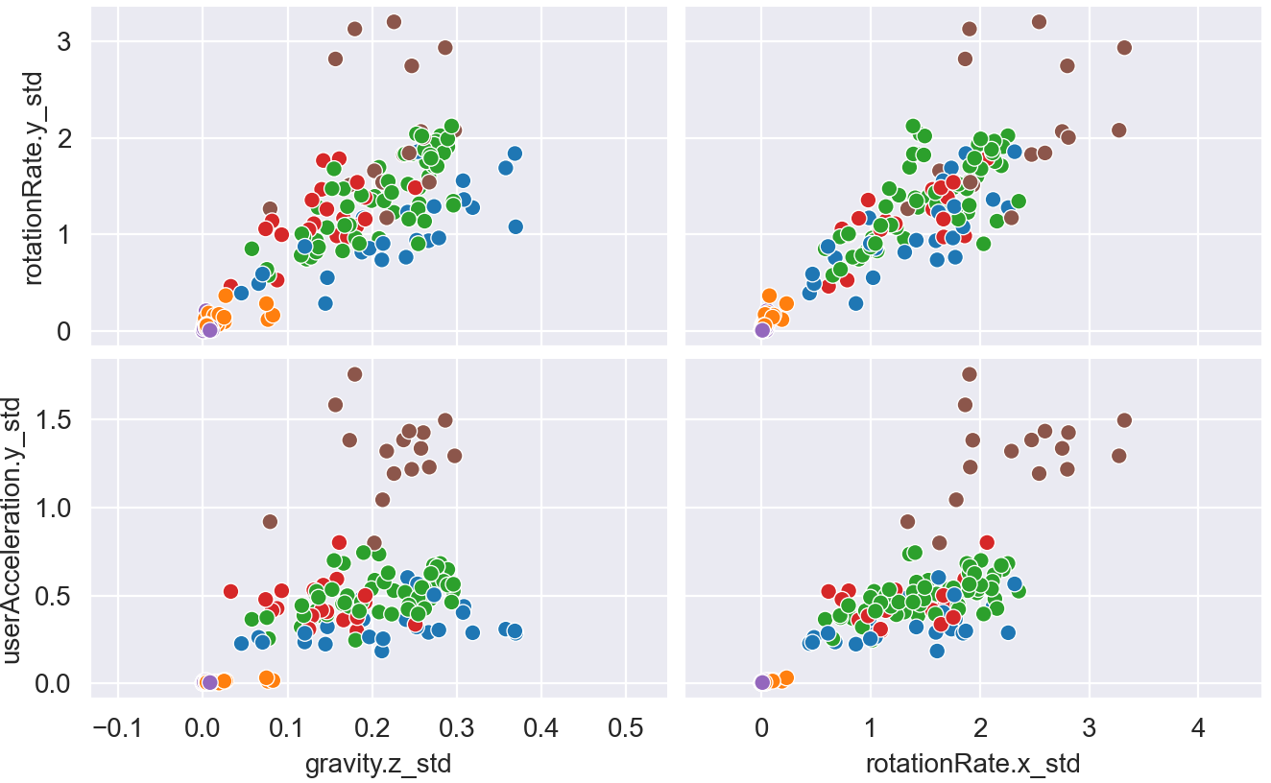
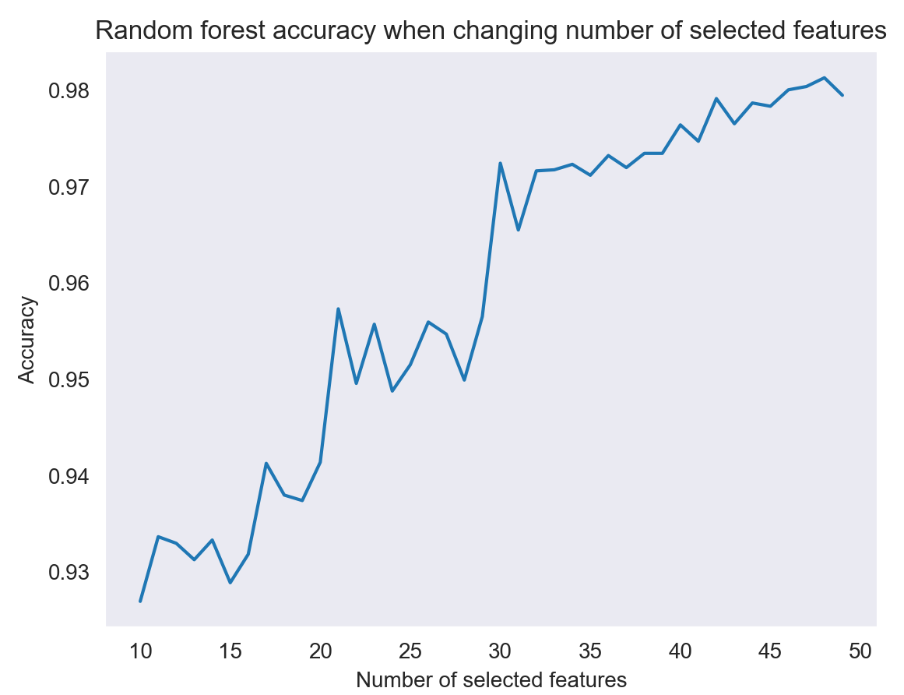
Feature redundancy and selection
Top 10 features:
gravity.z_std
rotationRate.x_std rotationRate.y_std rotationRate.z_std userAcceleration.x_std userAcceleration.y_std userAcceleration.z_std rotationRate.xP#2
userAcceleration.yP#2 userAcceleration.yP#3
Feature discarded: 21
Feature selected: 40

Slide 9
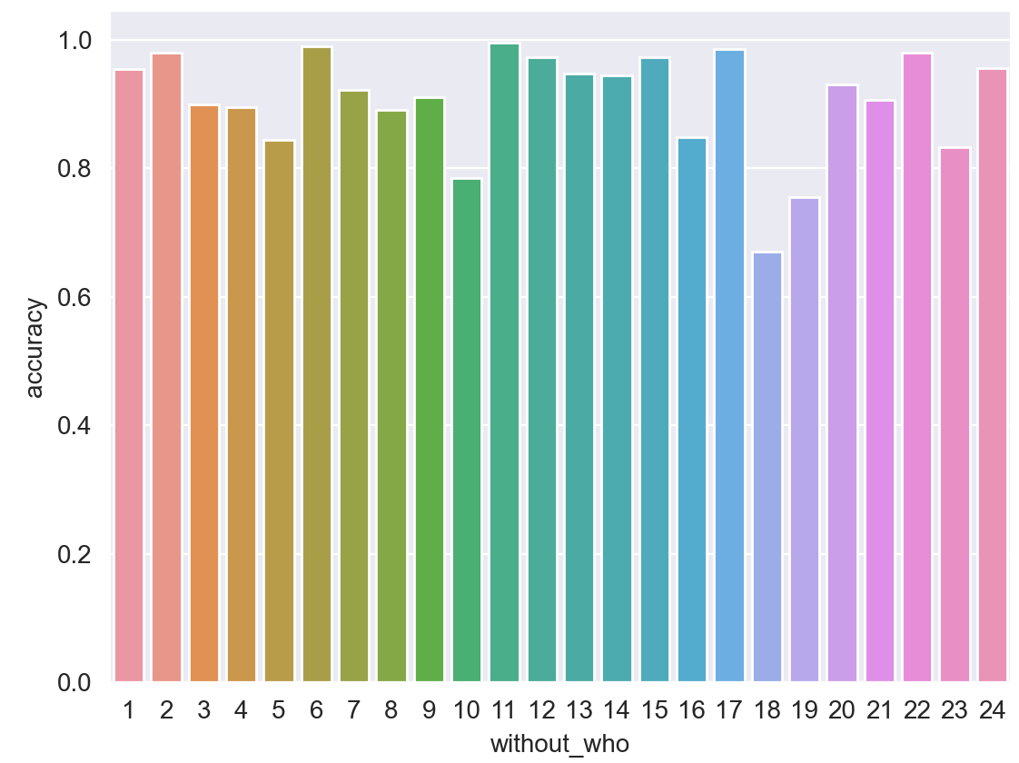
Model Evaluation (intra-dataset)
Experimental Results
 | Accuracy | Precision | Recall | F1_score
Random Forest Classifier | 0.91 | 0.94 | 0.91 | 0.91
Logistic Regression | 0.90 | 0.93 | 0.90 | 0.90
Decision Tree | 0.84 | 0.87 | 0.85 | 0.85
KNN-Classifier | 0.86 | 0.90 | 0.87 | 0.88
SVC | 0.90 | 0.90 | 0.92 | 0.92
GaussianNB | 0.70 | 0.76 | 0.70 | 0.72
Accuracy with standard cross validation: 97.4 %
Accuracy with leave-one-out strategy: 91%

Slide 10
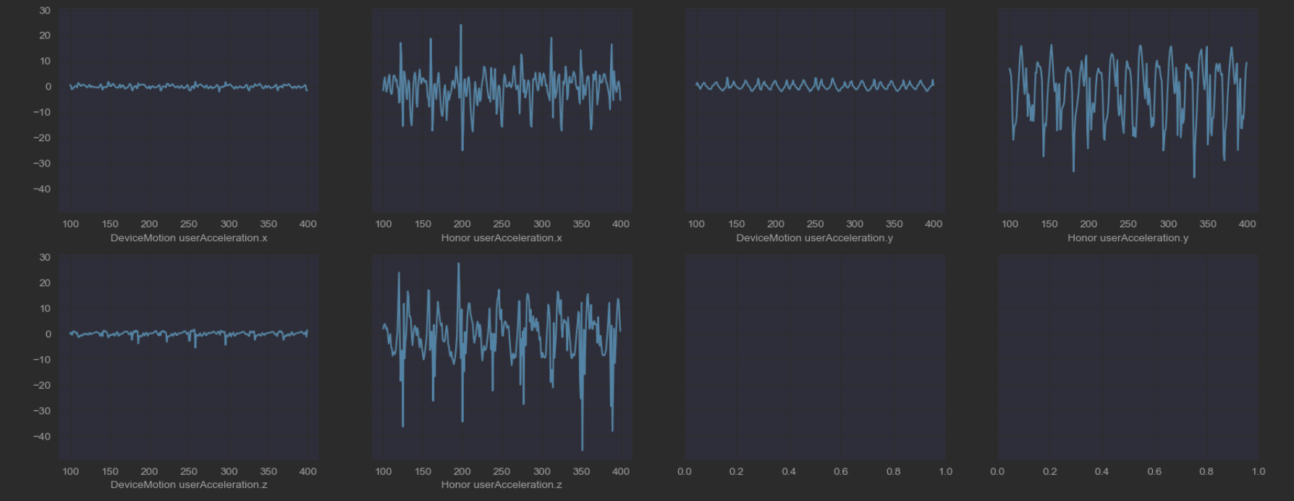
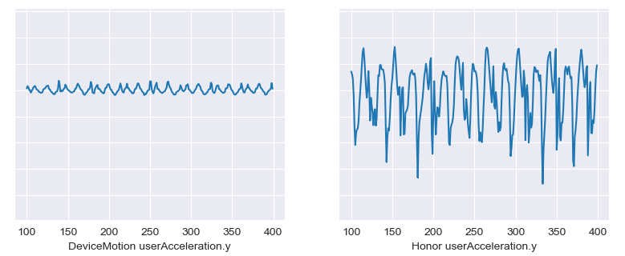
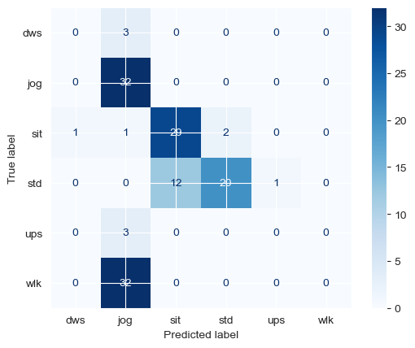
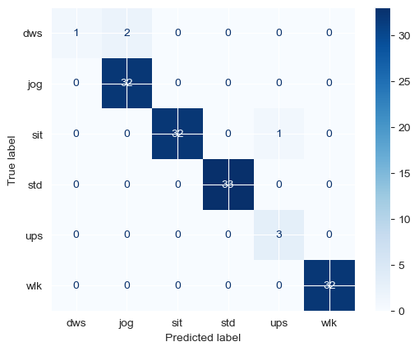
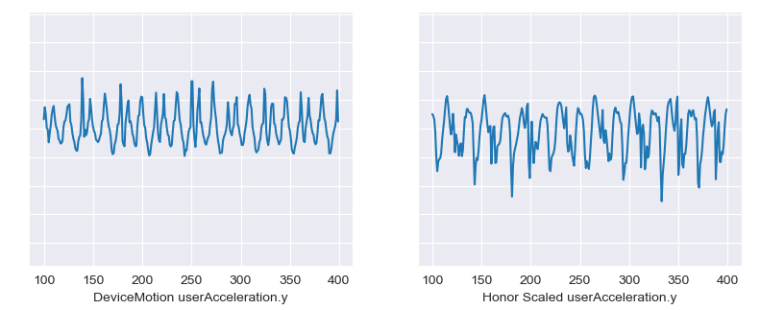
Model Evaluation (inter-dataset)
10 factor difference in Linear Acceleration between IPhone 6s and Honor 20
Accuracy after scaling: 98.52 %
Before scaling
After scaling

Slide 11
Application’s architecture
Client running on the phone, in charge of:
Starting the connection with the server
Starting a foreground service
Sending raw data to the server
Receiving the server’s response
Keeping track of movements of the user and of the results of the classification task
Showing them off when the activity is finished, together with a map of the movements, distance and elapsed time
Server written in Python, in charge of:
Collecting raw data coming from the phone
Elaborating them
Sending the correct class to the client

Slide 12
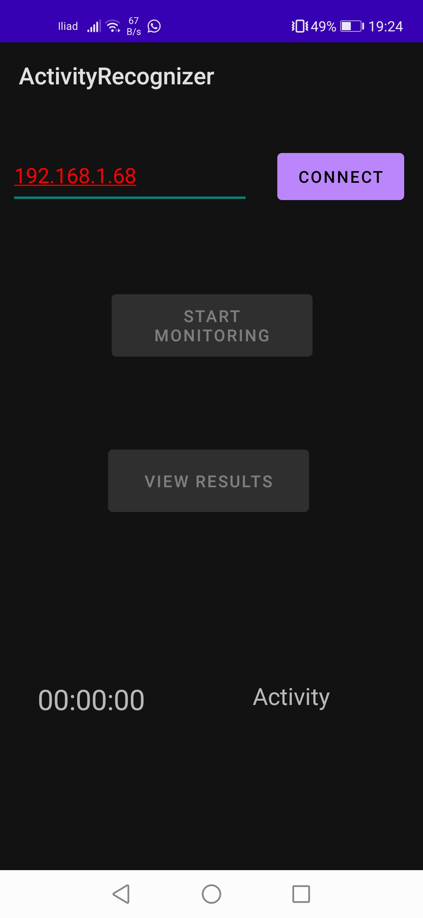
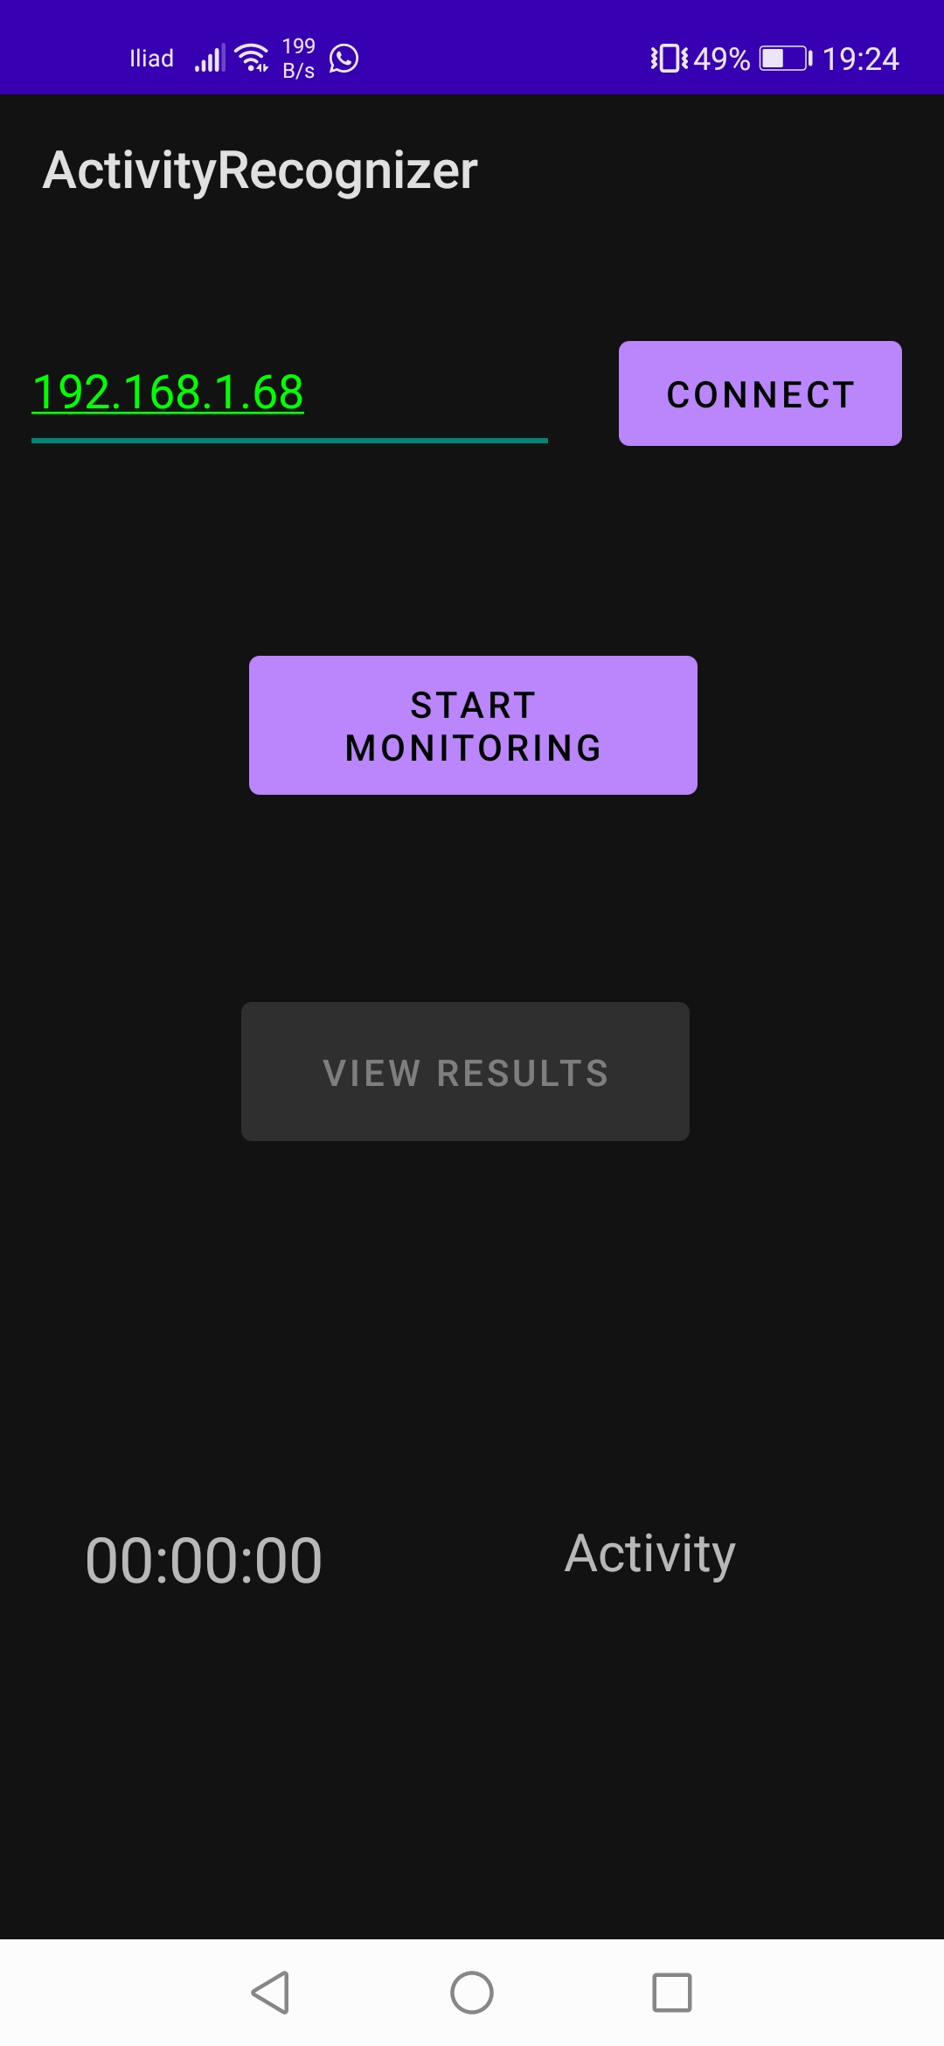
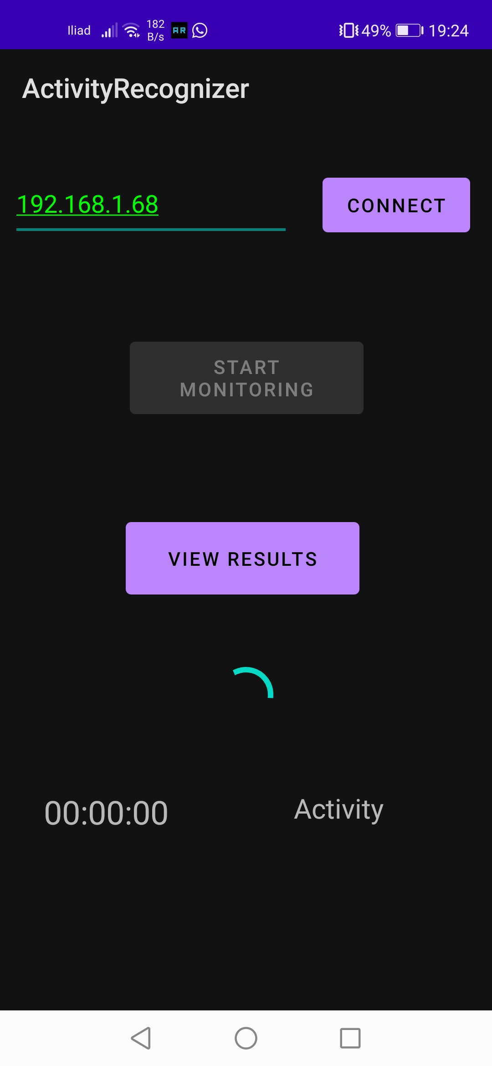
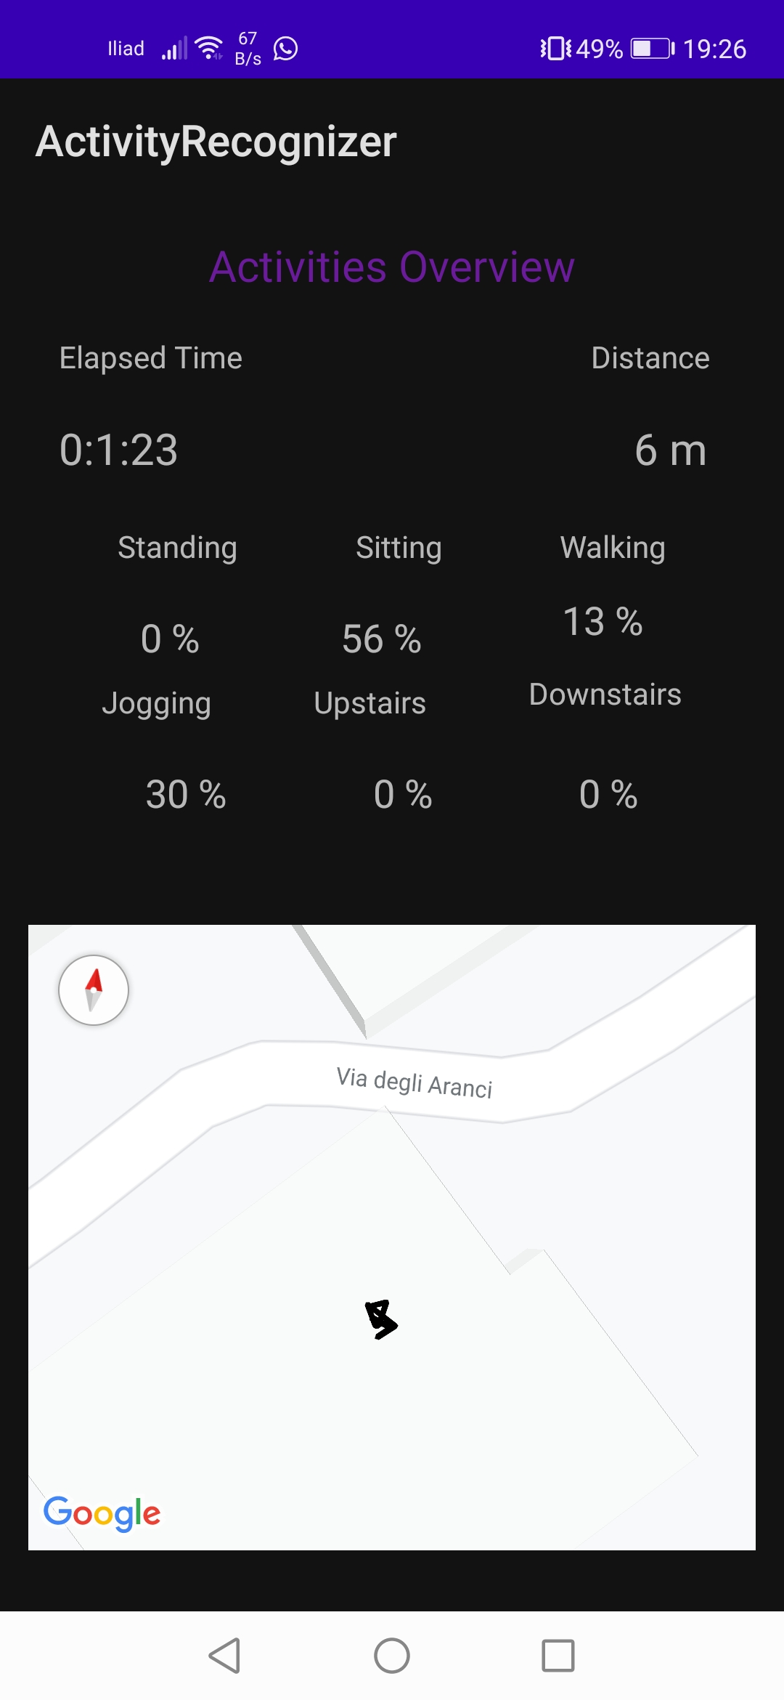
Application Highlights

Slide 13
Observations and considerations
1 hour of monitoring:
∼ 50*9*60*60*4 = 6’480’000 ∼ 6 Mb
Energy consumption evaluation + possible solutions
Client-server approach vs classifying directly on phone
Problems of the centralized approach
Comparison with other existing models
Should transitions be evaluated? How to find them out?
Would neural networks be more precise in this field?
Future improvements
Incorporate other sensors (maybe hearth rate from a smartwatch?)
Enlarge the number of phones used in the training set
Deploying the server onto the internet

Slide 14
Thank you!

